Slide 1

Beyond Clicks : Dwell Time For Personalization
Recommender Systems Best Paper Award in 2014
Alper KOCAMAN
2169589

Slide 2
Authors
Xing Yi ,
Yahoo Labs Sunnyvale,CA, USA
Liangjie Hong
Yahoo Labs, Sunnyvale, CA, USA
Erheng Zhong
Yahoo Labs, Sunnyvale, CA, USA
Nanthan Nan Liu Yahoo Labs, Sunnyvale, CA, USA
Suju Rajan
Yahoo Labs, Sunnyvale, CA, USA

Slide 3
The Paper’s
CategorIes and Subject DescrIptors: H.3.5 [Information Storage and Retrieval]: Online Information Services
General Terms: Theory, Experimentation
Keywords: Content Recommendation, Personalization, Dwell Time, Learning to Rank, Collaborative Filtering

Slide 4
Many internet companies, such as Yahoo, Facebook, Google and Twitter, rely on content recommendation systems to deliver the most relevant content items to individual users through personalization.
Delivering such personalized user experiences is believed to increase the long-term engagement of users.

Slide 5

There has been a lot of progress in designing effective personalized recommender systems by exploiting user interests and historical interaction data through ,
item click (implicit)
item rating - feedback (explicit)
However, directly optimizing for users’ satisfaction with the system remains challenging.

Slide 6

Traditionally, simplistic user feedback signals, such as click through rate (CTR) on items or user-item ratings, have been used to quantify users’ interest and satisfaction.
On the other hand, item CTR as implicit user interest signal does not capture any post-click user engagement. For example, users may have clicked on an item by mistake.
Matrix-completion based methods are also used very commonly in the field of recommender systems.
However, in many content recommendation tasks users rarely provide explicit ratings or direct feedback (such as ‘like’ or ‘dislike’) when consuming frequently updated online content. Thus, explicit user ratings are too sparse to be usable as input for matrix factorization approaches.

Slide 7
What this paper provides are:
exploring the idea of using item-level dwell time as a proxy to quantify how likely a content item is relevant to a particular user
01
describing a novel method to compute accurate dwell time based on client-side and server-side logging and demonstrate how to normalize dwell time across different devices and contexts
02
describing our experiments in incorporating dwell time into state-of-the-art learning to rank techniques and collaborative ﬁltering models that obtain competitive performances in both ofﬂine and online settings
03

Slide 8
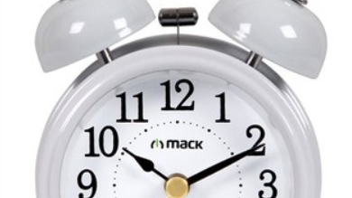
Firstly, what is dwell time?
denotes the time which a user spends viewing a document after clicking a link on a search engine results page (SERP).
Starts with the entering click
Finishes with the exiting click

Slide 9
How dwell time can be measured?
Dwell time can be measured from web logs.
Accurately computing item-level dwell time from web-scale user browsing activity data is a challenging problem.
Since most modern browsers have a multi-tabbed interface in which users can open multiple stories simultaneously and switch between them. ﬁguring out the tab that captured the user’s attention is non-trivial task.

Slide 10
2 complementary methods are described:
ClIent SIde LoggIng
Server SIde LoggIng

Slide 11
Client Side Dwell Time
Client-side logging utilizes Javascript/DOM events to record how users interact with the content story pages.
Examples of DOM(Document Object Model) events:
When a user clicks the mouse
When a web page has loaded
When an image has been loaded
When the mouse moves over an element
When an input field is changed
When an HTML form is submitted
When a user strokes a key

Slide 12
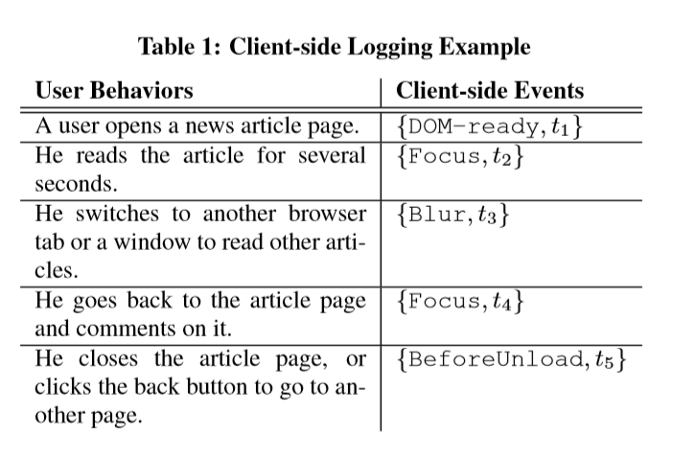

Slide 13
Problems with Client Side Logging
The major drawback of client-side logging is that it relies on the correctness of Javascript execution and on servers successfully receiving and logging client-sent data.
Data loss in this client-server interaction can be very high, for example, because of loss in internet connection.
In addition, users may also disable Javascript in their browsers.

Slide 14
Server Side Dwell Time
When client-side logs are not available, we resort to server-side logging to infer users’ attention on item pages.
The computation of dwell time on server-side are built on a number of heuristics.
There are 2 approaches :
Focus/Blur (FB) method
Last Event (LE) method

Slide 15
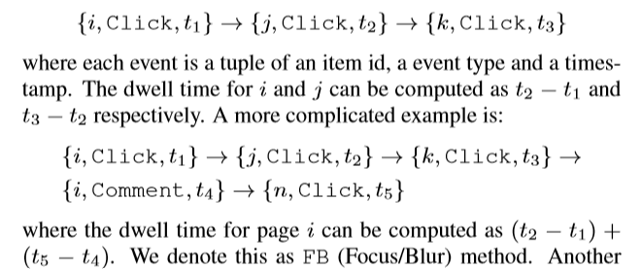
Focus/Blur Method

Slide 16

Weaknesses of Focus/Blur Method
The FB approach can over-estimate the dwell time because servers do not know the exact time the target story page loses its user attention. For the above example, if the last click happens on some other page, (t5 − t4) interval could includes some user time spent outside the target page.
The FB approach might also under-estimate the dwell time because servers also do not accurately know the time the target page gains user attention. For the above example, if users have returned to the target page and read it for some additional time before commenting at t4, the dwell time computation will not include the additional time.

Slide 17

Last Event Method
This method takes the last event of the page as the end-page event and compute the interval of the ﬁrst-event timestamp and the last one.
From the example, the dwell time of page i by last event method would be (t4 − t1).

Slide 18

Weaknesses of Last Event Method
The LE approach does not consider the scenario in which the users’ reading focus could switch among multiple browser page tabs, thus over-estimating the dwell time.
On the other hand, because the LE approach conservatively uses the last event on the target page to compute dwell time and servers do not know when the user abandons or closes the page (without the client-side unload event), it can also under-estimate the dwell time.

Slide 19
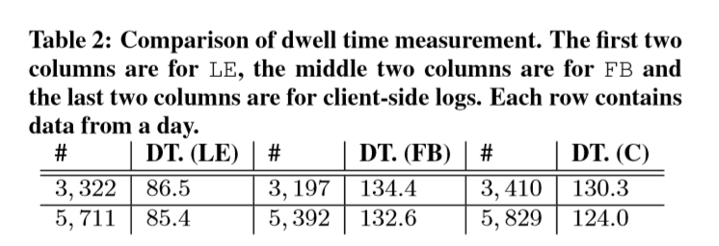
Because both approaches could over-estimate or under-estimate the item-level dwell time, a simple comparison study is conducted among FB, LE and the client-side logging. The results are shown in table.
The purpose of this study is to explore which server side approach can be used to better approximate the client-side logging.

Slide 20
From the table, we can see that the average dwell time computed by the FB approach is very close to the client side logging.
Meantime, the LE approach greatly under-estimates the dwell time, compared with the client-side events.
This result shows:
the FB approach better handles item-level dwell time computation in multi-tabbed modern browser setting.

Slide 21
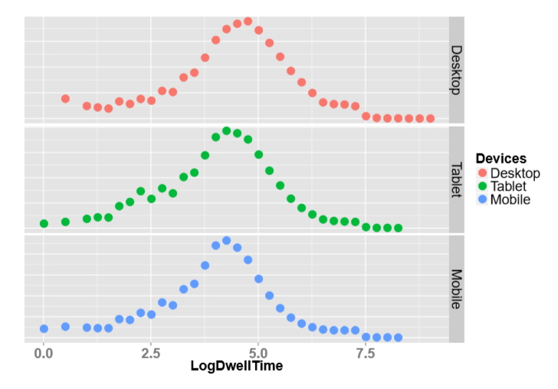
Dwell Time Analysis
In order to understand the nature of it, we analyze per-item per user dwell time from a large real-World data collection from Yahoo.
Unnormalized distribution of log of dwell time ,

Slide 22
Since dwell time approximates the time users spend on an item, it is natural to assume that given the same content quality, a longer news article would attract longer average dwell time across all users.
In order to demonstrate this behavior, this issue is investigated on text heavy news article and a plot is scattered for average dwell time per article versus article length.
In the figure, X-axis is the length of article and the Y-axis is the average dwell time of that particular article from all users.
Figure shows the scatter plot of the dwell time against the length of the article on different devices, namely desktop, tablet and mobile devices.
The black line is a ﬁtted linear line for a particular device type with the 0.95 conﬁdence interval in the grey area.

Slide 23
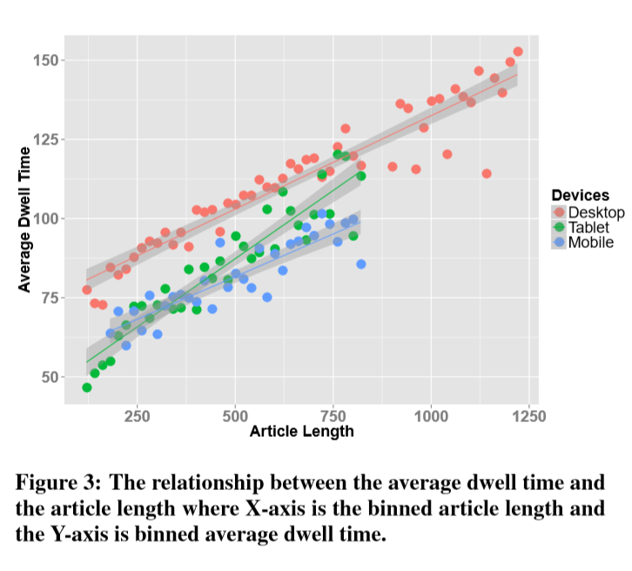
It is very clear that the length of the article has good linear correlation with the average dwell time across devices.
Also, the average dwell time on desktop is longer for long articles and the reading behavior on tablet and mobile devices are similar.

Slide 24
Furthermore, the correlation becomes weaker when articles are very long:
for desktop when the article is longer than 1,000 words, the plot has big variance; this indicates that users may have run out of their time-budget to consume the complete long story.
Although the high correlation between the length of articles and average dwell time naturally leads to using the length of articles as a feature to predict average dwell time, some important points that are based on the observed data:
per-user dwell time(rather than binned average dwell time over all users) has little correlation with the article length
long dwell time may not necessarily reﬂect that users are really interested in the article.

Slide 25
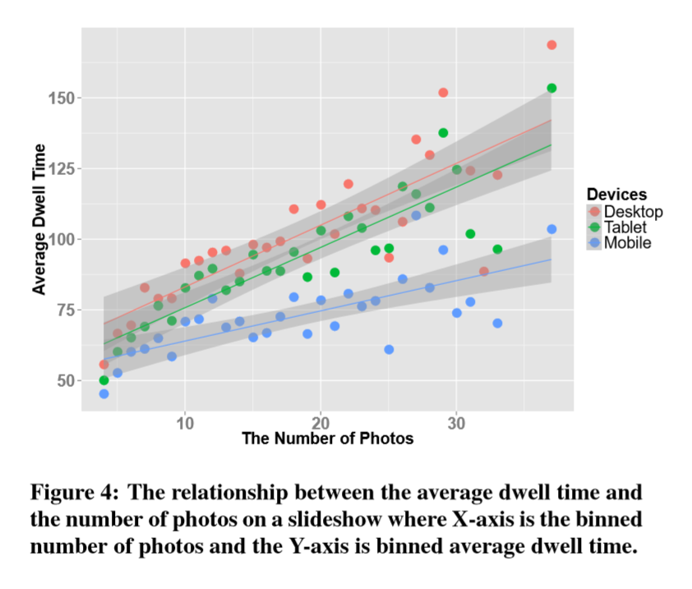
For slide shows, a natural assumption would be that the larger the number of photos/slides, the longer the average dwell time these items would receive over all users.
However, the relationship is demonstrated between the number of photos and the average dwell time on slideshows. It is clear that the correlation is not as strong as the length of articles. For videos, the similar weak correlations between the duration of a video clips’ and it’s average dwell time are observed as well.

Slide 26
Normalized Dwell Time
As may be obvious, users’ consumption of content items varies by context. For example, in historical data of Yahoo, it is found that users have on average less dwell time per article on mobile or tablet devices than on desktops.
Also, users on average spend less time per slideshow than per article.
Indeed, different content types, by their nature, would result in different browsing behaviors; thus different dwell times would be expected among these content types.
In order to extract comparable user engagement signals, authors of the paper introduce the normalized user dwell time to handle users’ different content consumption behaviors on different devices for personalization. The technique discussed in the paper can also be used to blend multiple content sources (e.g., slide-shows and articles) into a unified stream.

Slide 27
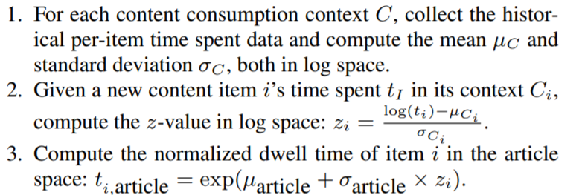
Thus, the idea is, for each consumed item, extract its dwell time based on user engagement level such that it is comparable across different context (e.g. content types, devices, instrumentations, etc.).
This is done by normalizing out the variance of the dwell time due to differences in context.

Slide 28
By normalizing dwell time,
all other types of items are now “comparable” after this transformation, and the normalized user engagement signals are then used for training recommendation models to handle different content types and can be deployed in different contexts.

Slide 29
Predicting Dwell Time
The average dwell time of a content item can be viewed as one of the item’s inherent characteristic, which provides important average user engagement information on how much time the user will spend on this item.
Predicting average dwell time for each content item can help labeling items when their dwell time are not available/missing.
For example, content items that have never been shown to users (such as new items) will not have available dwell time.
As another example, a user’s dwell time on her clicked story may not be always be computed because there may be no subsequent server-side events from the same user.
Therefore, leveraging predicted average dwell time can greatly improve the “coverage” (or alleviate the missing data issue). Not handling these situations, could degrade the effectiveness of applying dwell time in personalization applications.

Slide 30
A Machine Learning Model to Predict
The authors present a machine learning method to predict dwell time of article stories using simple features.
The features they consider are topical category of the article and the context in which the article would be shown (e.g., desktop, tablet or mobile).
They use Support Vector Regression (SVR) models to predict dwell time.
The model is trained from a sample of user-article interaction data.
Most features are categorical and they use log of Dwell Time as the model response.

Slide 31
Use Cases of Dwell Time
LEARNING TO RANK
COLLABORATIVE FILTERING

Slide 32
Learning To Rank
Learning to rank is used for how to leverage item-level dwell time to train machine-learned ranking (MLR) models for content recommendation.

Slide 33
The Basic MLR Setting
In traditional MLR, a query q is represented as a feature vector q while a document d is represented as a feature vector d.
A function g takes these two feature vectors and outputs a feature vector x = g(q, d) for this query-document pair (q, d).
Note that g could be as simple as a concatenation.
Each query-document pair has a response y, in traditional IR, which is usually the relevance judgment.

Slide 34
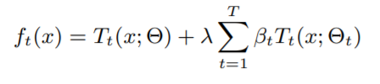
In this paper, authors use the Gradient Boosted Decision Tree (GBDT) algorithm to learn the ranking functions.
GBDT is an additive regression algorithm consisting of an ensemble of trees, fitted to current residuals, gradients of the loss function, in a forward stepwise manner. It iteratively fits an additive model as:
such that a certain loss function L(yi, fT (xi)) (e.g., square loss, logistic loss) is minimized, where Tt(x; Θt) is a tree at iteration t, weighted by a parameter βt, with a finite number of parameters Θt, and λ is the learning rate.

Slide 35
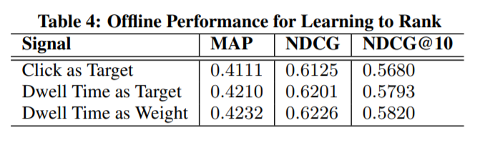
Dwell Time for MLR
Authors show the effectiveness of MLR model firstly from an offline experiment.
They use data from a bucket of traffic of a Yahoo property and split it uniformly at random into training and test sets, using a 70-30 split.
They repeat this sampling multiple times and the average results across all train-test splits.

Slide 36
COLLABORATIVE FILTERING
CF techniques utilize user engagement signals on particular stories to discover users who have similar reading interest from a broad audience and target them with the same or similar content.
In this paper, authors of the paper validate how dwell time can be used in CF frameworks to better improve the performance.

Slide 37
In this paper, they propose to use dwell time of users rather than asking them to give ratings or using click information as implicit rating feedback.
User feedback is represented as a M × N sparse matrix I, where M is the number of users, and N is the number of items, and each entry in the matrix is one user feedback, which is denoted as r{i,j} .
For dwell time, r{i,j} ∈ R or [0, 6] for normalized dwell time; for click/view, r{i,j} ∈ [0, 1].

Slide 38
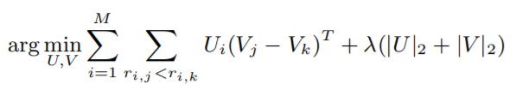
Formally, we aim to predict the unobserved entries in the matrix based on the observed data. Rank-based matrix factorization is used. We decompose the sparse matrix I as U and V , to minimize the following objective function
where r{i,j} refers to positive examples, r{i,k} refers to negative examples. The difference between the training process of dwell time and click is the bootstrap process of negative examples. For click, no-click feedbacks are treated as negative data. For dwell time, for each click with dwell time, we randomly sample another click feedback with less dwell time or non-click feedback.

Slide 39

Dataset
The data used in this experiment is collected from a bucket (a small sample traffic) of a Yahoo property, spanning a three month period.
They perform training on the first three months and prediction on last month. In this dataset, we have 147, 069 distinct users and 11, 535 distinct items, yielding 4, 358, 066 events in the training set and 199, 420 events in the test set.

Slide 40
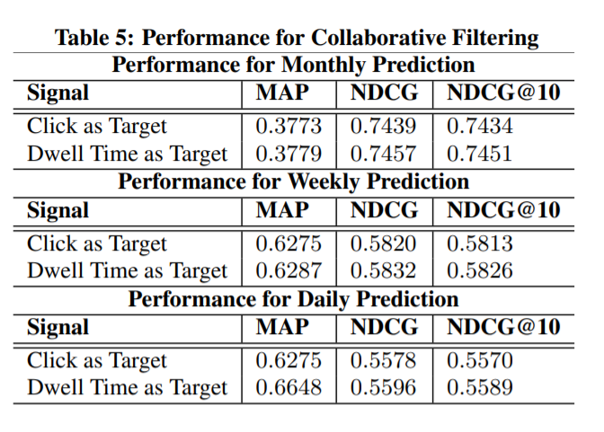
Experimental Results
There are two different strategies for evaluation.
The first experiment takes the data from first three months as training data while the last one as test data.
The second one is to use sliding window to perform daily or weekly prediction.
The overall performance is:

Slide 41
Discussions and Conclusions
In this paper;
how dwell time is computed from a large scale web log and how it can be incorporated into a personalized recommendation system,
several approaches for accurately computing item-level user content consumption time from both client side and server side logging data,
the dwell time distributions of different content types for normalizing users’ engagement signals into the same space,
using per-user per-item dwell time as the learning target and demonstrated that it can result in better performances for MLR,
dwell time as a form of implicit feedback from users and demonstrated how it can be incorporated into a state-of-the-art matrix factorization model, yielding competitive and even better performances than the click-optimized counterpart for CF
are proposed/explained.

Slide 42
References
http://www.hongliangjie.com/publications/recsys2014.pdf
https://en.wikipedia.org/wiki/DOM_events
https://www.searchenginejournal.com/dwell-time-seo/294471/
https://en.wikipedia.org/wiki/Dwell_time
https://en.wikipedia.org/wiki/Support-vector_machine

Slide 43

Thank you!

